Slide 1
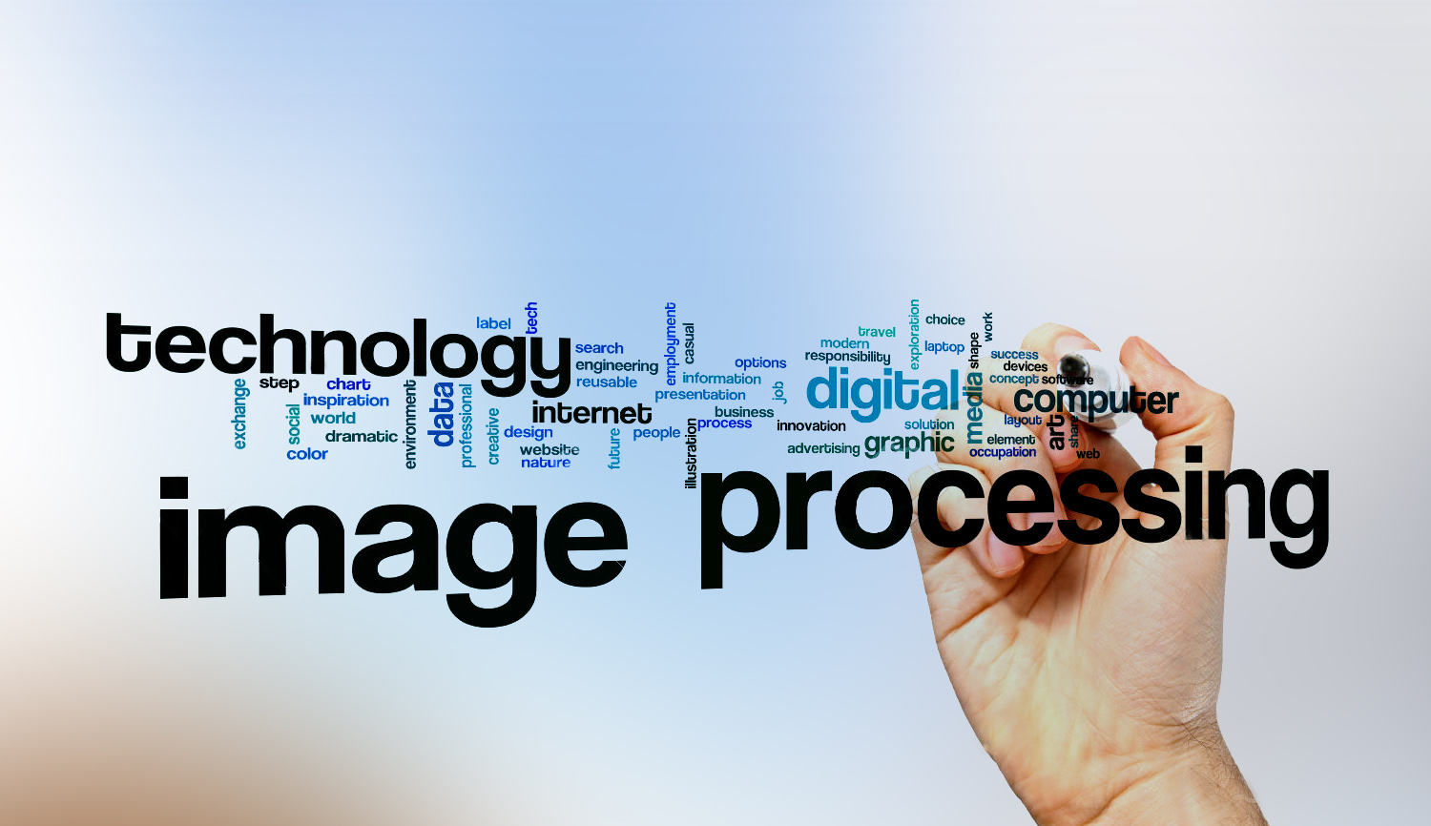
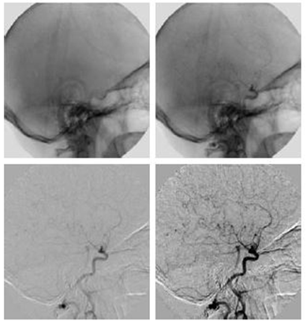
Digital Image Processing
9- Discuss how we can use image subtraction to make vans in a medical image more clearer.
x-ray image of the top of the head to see the vein clearly we put an iodine medium into the bloodstream.

